Slide 1
Notes:
These specific fleet applications PowerPoints can be given in conjunction with the Understanding Fleets and Alternative fuels materials or as stand alone pieces. They cover some of the brief intro and technical points of the workshop materials that are important to fleet managers looking to implement a specific fuel, technology, or strategy.
Tips for the Instructor:
This presentation is for the instructor. There are many ways to print out a PowerPoint presentation. Click on print, then look in the ‘Print What’ area and select handouts for participants. It my prove beneficial to select three slides per page which will give the audience room to take notes. For presentation purposes, the presenter can print out Notes Pages which displays one slide per page but will print out all of the Notes in this section. These notes can help guide the presentation and can be modified by each presenter.
PowerPoint can also be used by the presenter to use the notes electronically without requiring a physical hard copy for the presentation. Typically you will be presenting from a laptop or desktop that is connected to a projector. In order to use the notes electronically follow these instructions. Press the ‘windows’ and ‘P’ button and select extended view. Open the PowerPoint presentation. Click on the Slide Show tab. Ensure that the box next to ‘Use Presenter View’ has been checked. Then in the upper left hand corner click Play From Beginning. This will present the slides for viewing on the projector screen while allowing the presenter, yourself, to view both the slide and notes section on your desktop/laptop screen. The Notes Page is on the right and has a zoom button to zoom in or out to appropriately size the font for easy reading. On your laptop/desktop window you can use the mouse to click the arrows beneath the currently viewed slide to advance throughout the presentation. To exit this method of presentation, push ESC on the keyboard.

Slide 2
Objectives
Explain how to implement green fleets
Learn about incentives for converting to ethanol fleets
Learn about the availability and cost of ethanol fuel
Identify the advantages of using ethanol
Understand how to safely handle ethanol
Notes:
Each of the specific PowerPoints include general information on why fleet managers may want to consider converting to a green fleet. Some reasons include….next slide

Slide 3
Greening of Fleets with Ethanol
Why Use Green Fleets?
  Reduce operating costs
  Reduce greenhouse gas emissions
  Improve corporate image
Notes:
Reduce operating costs by improving efficiency, reducing lifecycle costs, and reducing vulnerability to volatile fuel prices
Reduce GHG emissions by implementing the use of ethanol in vehicles, which are the primary source of GHG emissions and urban air pollution
Improve corporate image by branding business strategies and appealing to public concerns about energy conservation and ecological sensibilities

Slide 4
How to Implement Green Fleets
  Get buy-in
  Create long-term objectives
  Avoid setting reduction goals in absolute numbers
  Anticipate obstacles
  Take things slow
  Track and report progress
Notes:
Get buy-in from all management and staff levels – be sure to communicate information about the benefits, goals, and targets frequently
Create long-term objectives and tangible goals based on best practices in the industry (baselines, benchmarks, etc.)
Avoid setting reduction goals in absolute numbers for growing fleets or fleets just starting because absolute goals can impede growth
Anticipate obstacles such as driver resistance, lag time between original equipment manufacturers technology and market availability, and slower return on investment
Move slowly and implement change over time
Improve vehicle use with selection analysis and education of drivers
Track and report progress and share successes with employees, shareholders, and the public

Slide 5
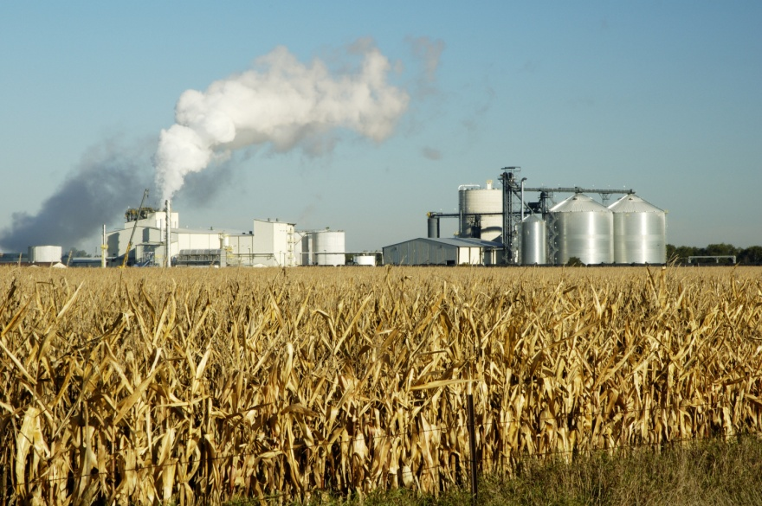
Ethanol Fleets
Ethanol = recognized alternative fuel, renewable
Ethanol first used as transportation fuel in late 1800s
Henry Ford used
ethanol in
“Quadricycle”
Figure 1: Corn is a primary feedstock in ethanol production. Source: NAFTC.
Notes:
Ethanol is a high octane, oxygenated, renewable alternative fuel…however it should be noted that different agencies define alternative fuels differently…for example it is not recognized by the IRS as an alternative fuel but tax incentives for use and production have been implemented in the past
For a little history about the fuel itself…second bullet
Older engines had adjustment screws on the engine to adjust between running on gasoline or ethanol…due to its different energy density
In fact…last bullet
Today, vehicles capable of using high ethanol blends are typically called flexible fuel vehicles FFVs and can run on ethanol and gasoline blends E85

Slide 6
Corn
Sugarcane
Wheat
Other agricultural products
Notes:
The feedstocks used to produce ethanol can be grown and harvested domestically
Corn is currently the main feedstock used in about 90% of ethanol production
Government mandates are limiting corns use so that other feedstocks are developed

Slide 7
Ethanol is typically produced through dry milling
  Feedstock is ground and mixed with water to form mash
  Mash is heated; enzymes and yeast are added
  Mixture is fermented; ethanol is distilled out
Typically transported via truck or rail car
Most ethanol is produced in Midwest
Notes:
How is ethanol produced?...Well…first bullet
Three sub bullets are the basic steps in dry milling and fermenting process which creates grain alcohol…or ethanol
Once ethanol has been produced it is typically denatured to prevent consumption and is then transported across the country
…Second main bullet
And…last bullet
Ethanol is often an additive in fuel treatments because of its ability to attach to water in conventional fuel tanks, for this reason it requires different transportation and distribution systems to ensure that it does not have excessive water

Slide 8
Nearly all gasoline sold in U.S. contains ethanol
E10 (10% ethanol, 90% gasoline) = popular blend
8.5 million FFVs on the roads
FFVs can utilize blends up to E85
Notes:
Continuing with some more facts that hopefully help to increase general acceptance of ethanol as a fuel…
If you don’t already know…first bullet
And a common blend is …second bullet…next time you fill up at a pump look for stickers that say this fuel may contain up to 10% ethanol in fact…E15…may be available soon and is approved for use in all 2001 and newer vehicles
Ethanol as an alternative fuel typically means E85 which is a blend of ethanol and gasoline that can contain up to 85% ethanol
Vehicles that are capable of using this blend of fuel are called flexible fuel vehicles or FFVS and there are currently…third bullet

Slide 9


Figure 2: GM flexible fuel vehicle badge. Source: GM.
Figure 3: Ford flexible fuel vehicle badge. Source: Ford.
Notes:
Every brand has their own labels and not all flex fuel vehicles come with labels so check the fuel cap, E85 compatible fuel system caps should be yellow and have the appropriate labeling

Slide 10
Incentives for Using Ethanol in Fleets
Incentives
  Partnership initiatives and pooled resources
  Financial subsidiaries
  Informational tools
Initial cost vs. federal and state incentives
American Recovery and Reinvestment Act (ARRA)
Clean Cities Program
Notes:
A general slide about incentives for renewable and alternative fuels
Incentives allow AFVs to be a competitively priced option for fleets
Fleet managers have been purchasing AFVs in order to meet federal and state emissions and fuel economy standards
In 2009, the U.S. DOE made nearly $300 million of the American Recovery and Reinvestment Act available through the Clean Cities program
Among other things, this $300 million helped put more than 9,000 AFVs on the road and established 542 fueling stations across the country

Slide 11
Tax Incentives
  Previously available on federal and state levels
  Over $20 billion in subsidizing the ethanol industry
Notes:
For tax credits by state: http://www.afdc.energy.gov/afdc/laws/search
As federal and state incentives change and may not currently be available.

Slide 12
Federal Grant Funding
  Federal government = largest grant provider
    U.S. Department of Energy (DOE)
    U.S. Department of Transportation (DOT)
    Environmental Protection Agency (EPA)
    U.S. Department of Agriculture (USDA)
Notes:
When implementing any alternative fuel or advanced technology vehicles, check with the following federal organizations to see if funding is available.
The federal government is the largest and most consistent source of grant funding
Transportation-related grants mainly come from:
DOE
DOT
EPA
DOA
Opportunities from each of these agencies are available on each respective website

Slide 13
State Grant Funding
  State Energy Office (SEO)
  National Association of State Energy Officials directory
  Alternative Fuels Data Center map
  To find state-specific information, visit
  www.afdc.energy.gov/afdc/laws/state
Notes:
Also check for state opportunities, these can be updated or changed with specific examples in your state.
Each state has several different alternative fuel grant opportunities
The largest provider of grants for most sates is the State Energy Office (SEO)
The State Energy Office for each state can be found in the National Association of State Energy Officials (NASEO)
The Alternative Fuels Data Center published a web-based map that allows users to click on each state and find information on alternative fuel incentives and funding projects

Slide 14
Incentives for Ethanol Production
and Infrastructure
  Multiple tax incentives for biofuel production
  Rural Energy for America Program (REAP)
Notes:
And for those looking to help increase the production of ethanol…
REAP focuses on small business and agricultural produces that require the purchase of ethanol compatible equipment to blend and dispense the fuel
Congress continues to invest in biofuel production, 2020 target of 36 billion gallons of which only 15 billion gallons can be corn based ethanol

Slide 15
Ethanol Availability and Cost
Widely available around the globe
Ease with which ethanol can utilize existing infrastructure
FFVs are not radically different from conventional vehicles
Ethanol is already blended with up to 97% of gasoline used in the U.S.
Notes:
Some important points to weigh during the decision making process is availability and cost…
Ethanol is…first bullet…in fact some countries use ethanol as the major fuel of the country and their economy could be considered ethanol driven
Second bullet…some modifications are needed to infrastructure and vehicles but the use of ethanol as a transportation fuel would be no different to fleet managers or consumers when compared to conventional gasoline
So there's not much difference in the vehicles…third bullet
And ethanol is not a new fuel…last bullet

Slide 16
Ethanol generally costs less than conventional gasoline
Fluctuations in oil price affect the price of conventional gasoline
Ethanol has 75% of the energy density of gasoline
Direct cost comparison vs. cost per energy density
Notes:
First bullet…but this does vary by location and it could cost more in your area
Second bullet…so these fluctuations will affect E85s price since it contains some conventional gasoline but since it is domestically produced it is the potential to be more stable
And also remember if you are going to use ethanol…it has…third bullet
So if you are using higher blends like E85…the actual fuel mileage may be less than conventional gasoline vehicles…but this is to be expected and its not a problem of the engine or fuel…just a characteristic of the fuel property…so for alternative fuels it is better to do…last bullet…which we can show in a few slides

Slide 17
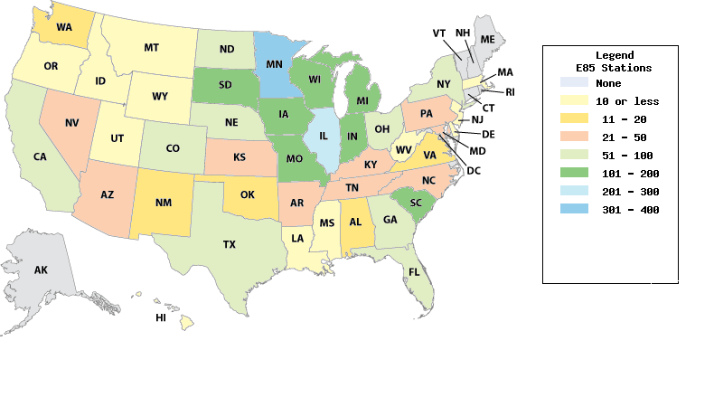
Figure 4: Ethanol E85 refueling stations. Source: AFDC.
Notes:
But first well show a graphic of station location and count
We can be seen on the map that E85 stations are more popular near areas of production in the midwest

Slide 18
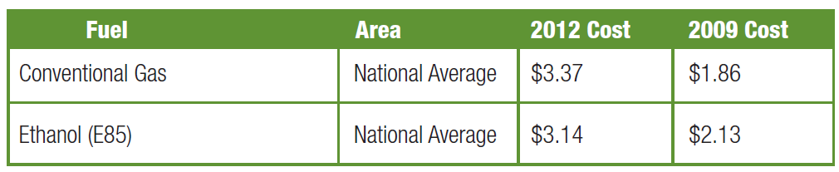
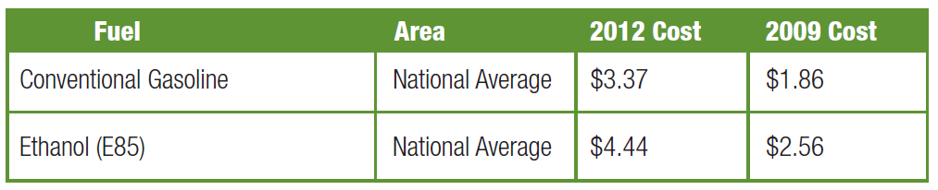
Figure 5: E85 and conventional gasoline cost comparison, 2009-2012. Source: AFDC.
Figure 6: GGE price comparison of E85 and gasoline. Source: AFDC.
Notes:
As mentioned before the price of ethanol may be less than gasoline as shown in figure 5…but ethanol also has a lower energy content so it will require additional fuel for the vehicle to do as much ‘work’….travel the same amount of miles
But even though it may cost more…it is a domestically produced and cleaner burning fuel…which is most likely worth the additional cost to fleets that are aware of their carbon footprint

Slide 19
Ethanol price depends upon:
  Amount of ethanol used in blend
  Raw materials used to produce the ethanol
  Seasonal weather effects on ethanol production
  Processing and distribution expenditures
  Distance from refinery to fueling station
Notes:
Just with conventional fuels…the price of ethanol will fluctuate and …slide title
Again point back to the map for more stations located in the midwest
Last bullet…Mainly due to water absorption problems from distribution in existing pipelines…so it must be hauled by other means…trucks, trains across the country

Slide 20
Ethanol Advantages
Produced domestically from renewable resources
Fewer emissions, including particulate matter and greenhouse gases
Relatively harmless if spilled on land or water
Requires only minor changes to existing refueling infrastructure
Will create a new job market and help support local economies
Notes:
So if it is available and the price is competitive what are some other advantages?
Well we cant say enough that ethanol is…first bullet
And due to its chemical properties, its use can produce…second bullet…which can be harmful to human health and the environment
Additionally, third bullet…in pure form it is biodegradable and even when mixed with gasoline less of a toxic threat when spilled
Fourth bullet…Because of its corrosive nature…some metals/seals will need replaced…but the transition to fleets and consumers is seamless compared to conventional fuels
And back to the first bullet and energy security and economy…ethanol use…last bullet

Slide 21
Operations help rural development
FFVs are sold at prices comparable to those of conventional vehicles
Vehicles offer the same performance as conventional vehicles
FFVs do not introduce any new maintenance requirements
Notes:
And many of these jobs can provide for…first bullet…where jobs are needed
Now when looking at vehicles themselves…second bullet…so consumers and fleet managers will hopefully not be deterred based on price…and…third bullet…and…fourth bullet

Slide 22
Things to Consider
  Lower fuel economy and energy density
  Low volatility when cold – this can cause cold-engine start problems and misfiring during warm-up
  High volatility when warm – this can result in evaporation and reduction in fuel economy
  Limited station location – major obstacle
Notes:
Additionally…just want to be clear
E85 does have a lower energy content by gallon and there for a lower the vehicle will decrease in MPG but…
Most manufacturers place slightly larger fuel tanks in FFVs in order to maintain the same range
The engines themselves are NOT less efficient
Second and third bullets are a fact of the fuel…but vehicle manufacturers and fuel blenders have already addressed these issues so that FFVs are easy to use and produce lower emissions
Perhaps the most important thing to consider is….last bullet…so be aware of local station locations and use them with FFVs whenever possible

Slide 23
Ethanol Performance and Safety
Performance
  Performance aspects of FFVs are comparable to conventional vehicles
  FFVs have the same:
    Power
    Acceleration
    Payload
    Cruise speed
Notes:
Now lets look at the vehicle and fuel use together in terms of performance and safety
For performance…first sub bullet
And with modern engine control and sensors…these flexible fuel vehicles or FFVs have the same…sub ‘sub’ bullets

Slide 24
  Burns more completely – high octane
  Higher compression
  More volatile than conventional gasoline – evaporates less quickly in cold weather, more quickly in hot weather
  Summer and winter blend differences
Notes:
And for environmentally concerned citizens and fleet owners, you can get the same performance with a fuel that…first bullet
Ethanol also has a higher octane number which means it is resistant to engine knock and could be used in engines with…second bullet…which could improve efficiency
Third and fourth bullets are for the fuel itself…and really don’t affect performance of today's advanced vehicles but may affect fuel economy because…
The actual % of ethanol at the pump will vary depending on weather in order to maintain vehicle performance due to cold weather issues
Most FFVs do not yet take full advantage of higher compression ratios when using E85

Slide 25
Ethanol Performance Summary
Comparable in all aspects to gasoline
Reduces engine knock
Prevents gas line freeze-ups
FFVs can operate seamlessly on any blend up to 85%
Notes:
Highlights of performance

Slide 26
Safety
  Relatively safe when compared to conventional gasoline
  Nontoxic and biodegradable, in pure form but is denatured making it unsafe for consumption
  Pure ethanol and E85 are less toxic than conventional gasoline
Notes:
And now back to safety…of the fuel
Ethanol is…first bullet…all fuel pose some risks
Pure ethanol is also…second bullet
And in pure or blended form is less toxic than conventional gasoline

Slide 27
Safety
  Pure ethanol does not contain carcinogenic compounds
  Diamond placards:
    3 = ethanol can be ignited under almost all ambient temperature conditions
    1 = intense or continuous exposure
    to ethanol can lead to
    incapacitation
    0 = ethanol poses no reactivity
    hazards
Figure 7: NFPA 704 hazard placard for ethanol. Source: NFPA.
Notes:
Continuing with safety
First bullet…
And for those that will store ethanol blended fuels onsite you will need to be aware of the proper placards for bulk fuel storage…this placard is an example of one required for ethanol storage based on the national fire protection association, NFPA

Slide 28
Safety
  Small fires should be extinguished with a dry chemical, not water
  Large fires should be extinguished
  with an alcohol-resistant foam
  Ethanol blends conduct
  electricity – care should be
  taken when cleaning a spill
Figure 8: Hazardous material description identification number UN 1170 for ethanol. Source: USDOT, PHMSA.
Notes:
Also important for those storing, transporting, or responding to ethanol fires…first bullet…second bullet…and be aware that….last bullet
For those transporting ethanol…always ensure you obtain the proper permits and placards. United states department of transportation placard shown in figure 8.

Slide 29
Ethanol Safety Summary
Fewer greenhouse gas emissions
Biodegradable
Potentially carcinogenic in E85 form
Conducts electricity
Notes:
And we will wrap up with the Highlights of safety… a few questions on the next slide

Slide 30
Test You Knowledge
True or False: The majority of gasoline sold in the U.S. is blended with ethanol.
Ethanol can be produced from sugar cane, wheat and other biomass. Although the majority of ethanol is produced from _______________.
True or False: The biggest obstacle for widespread ethanol use in fleets is the limited number of refueling stations.
True or False: Pure ethanol is a renewable resource.
True or False: Ethanol is safe to drink.
Notes:
During the presentation, the location of information that may help answer the test your knowledge has been hyperlinked to a hidden box next to each number. When the pointer slides over the area just to the right of the number it will give you the option to click the hyperlink which will take you to the appropriate slide. To return, right click your mouse and go to Last Viewed to the test your knowledge section. It should also be noted that information in the workbook has also been marked in the margins with PowerPoint slide numbers. More information about each slide and question can be found in the text.
True
Algae
True
Reduces operating costs; reduces GHG emissions; improves corporate image
True

